Slide 1
End-to-end audio encoding and ASR and phonetics
(Interspeech 2023)

Slide 2
Can we understand what Wav2vec2.0 distinguishes?
In Wav2vec2.0
  CNN is used as feature encoder
  transformer layers are used to map the high-dimensional CNN representations to the elements of some lexicon.
We fine-tuned a Wav2vec2.0 system for producing broad phonetic transcriptions of Dutch.
We investigate to what extent internal representations of a pre-trained and fine-tuned Wav2vec2.0 model reflect widely-shared phonetic knowledge.

Slide 3
Software (more details later)
Enormous amount of scripts available on the web
https://docs.pytorch.org/audio/stable/tutorials/speech_recognition_pipeline_tutorial.html
Huggingface
Many more
You can choose yourself

Slide 4
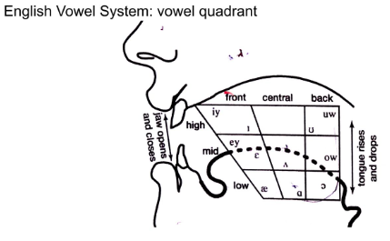
Vowel structure
vowels show phonetic structure
we focus on the role of phone competition in an end-to-end model by investigating three related aspects:
  the Kullback-Leibler divergence between phone pairs,
  the within-frame phone ambiguity,
  the interpretation of the competition between winning and runner-up phone in terms of ’classical’ phonetic structure.

Slide 5
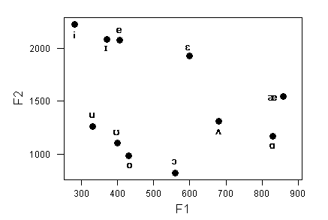
Phonetic theory
Phonetic theory “predicts”
how vowels are organized
Can we see this in the competition structure in the latent representations in Wav2vec2?

Slide 7
Spatial organization

Slide 9
Probability vector → competition → entropy

Slide 10
Data, model
News broadcast component (component 'k') from the Spoken Dutch Corpus (CGN, 27 hours of materials)
Wav2vec2 system was finetuned towards the classification of 37 phones in Dutch

Slide 11
Method 1 (‘horizontal’)
Decode utterances from a corpus
  the news broadcast component (component 'k') from the Spoken Dutch Corpus (27 hours of materials)
S2T finetuned towards the classification of 37 phones in Dutch.
store the 1024-D representations on all hidden layers for all utterances
  Also the 512-D CNN representations
K-Means clustering to create codebooks with 512 entries, and replaced the 512-D or 1024-D frame vectors with the number of the closest code word (using Euclidean distance).
For each of the 37 phone labels: we construct a histogram of the resulting code word counts from which we obtained 512-D vectors that describe p(frame | phone).
Kullback-Leibler (KL) divergence between all pairs of phone probability vectors

Slide 12
Method 1
Store the 1024-D representations on all hidden layers for all utterances
  And the 512-D CNN representations, which are as close as we can come to the speech signals
KMeans clustering to create codebooks with 512 entries
  Euclidean distance
Each phone → a histogram that describes p(state | phone)
the Kullback-Leibler (KL) divergence for all phone pairs

Slide 13
KL divergence
Figure on next slide shows the (non-symmetric) KL divergence for all phone pairs for the representations on the CNN output layer and layers nr 12 and 24 in the transformer.
It can be seen that on the CNN layer there is some evidence of acoustic-phonetic structure, but on the (higher) transformer layers that structure is much less apparent.
Importantly, this does not mean that those representations contain weaker phonetic information.

Slide 14
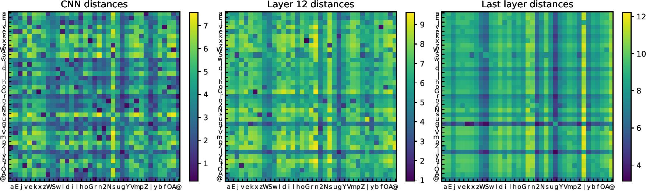
Figure shows (non-symmetric) KL divergence for all phone pairs
for the representations on the CNN output layer and layers nr 12 and 24 in the transformer
CNN layer: there is some evidence of acoustic-phonetic structure,
but on the (higher) transformer layers that structure is much less apparent

Slide 15
Probing classifiers
Classification accuracy (%) of the MLP phone classifiers on a held-out test set in the Spoken Dutch Corpus.
layer | pretrained | Finetuned (CTC)
CNN | 69
1 | 84 | 93
12 | 92 | 94
24 | 94 | 98

Slide 16
Figure 2 shows that, across the board, there is a sub-stantial difference between BPCs and the random phone sets in terms of the KL divergence with the observed MLP-based phone PDFs.
Clearly, the comparison differs for the different layers in the Wav2vec2 model, and is different for the pretrained and finetuned variant.
Interestingly, the KL-divergence does not differ for layer 24 from the CTC fine-tuned model, while the MLP phone classifier performed best in the phone classification

Slide 17
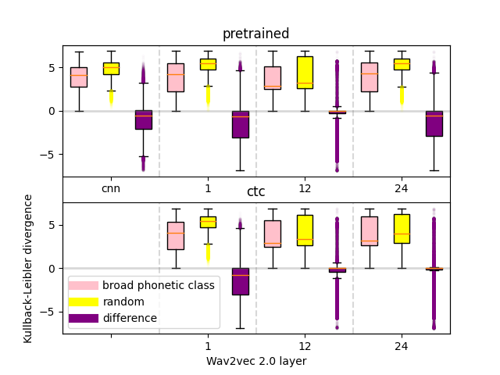
Figure 2: The distribution of KL-divergences scores for BPC PDF, random PDF and the difference
between the KL-divergence scores for BPC and random.
The negative values are only present for the difference between the
BPC and random based KL-divergence scores
Clearly, the comparison differs for the different layers in the Wav2vec2 model, and is different for the pretrained and finetuned variant. Interestingly, the KL-divergence does not differ for layer 24 from the CTC fine-tuned model, while the MLP phone classifier performed best in the phone classification

Slide 18
Probing (‘horizontal’)
We show that MLP-based classifiers perform adequately on the latent representations for all layers while the internal phone-phone structure shows a varying pattern across layers.
This suggests that while phone classifiers are able to produce a likely correct winner, given a latent representation, a phonetically motivated phone-phone structure in the latent space is not necessary.
Details see papers

Slide 19
Probing classifier (MLP)
The table presents the phone classification accuracy (%) on an independent held out test set from component ’o’ in the Spoken Dutch Corpus
Layer | Pretrained | Finetuned (CTC)
CNN | 69
1 | 84 | 83
12 | 92 | 94
24 | 94 | 98

Slide 20
Method 2: ‘vertical’
Given trained MLPs, we study the competition between phones according to the MLP output vector.
by counting the number of times a given phone appears as the runner-up of a winning phone.
Figure 3 gives an overview of the percentage of runner-up phones sharing the same BPC as the winning phone, across all MLP-output vectors on a particular layer.
BPC = broad phonetic class
  {p,t,k}, {b,g,d}, {s,z} {f, v} {i, e}, {..}

Slide 21
Phone–phone competition
Fig. 3 shows the intrinsic phone-phone competition per MLP input vector, that is, at a given location in the latent space.
It raises the question to what extent these runners-up reveal information about the intrinsic phonetic structure. Evidently it can be expected that the overall statistics of the runner-up is informed by the phonetic neighborhood of the winning phone.
For the plosives,nasals and fricatives this occurs fairly often even in the middle layers of the model, while this is not the case for the high, some middle and low vowels.

Slide 22
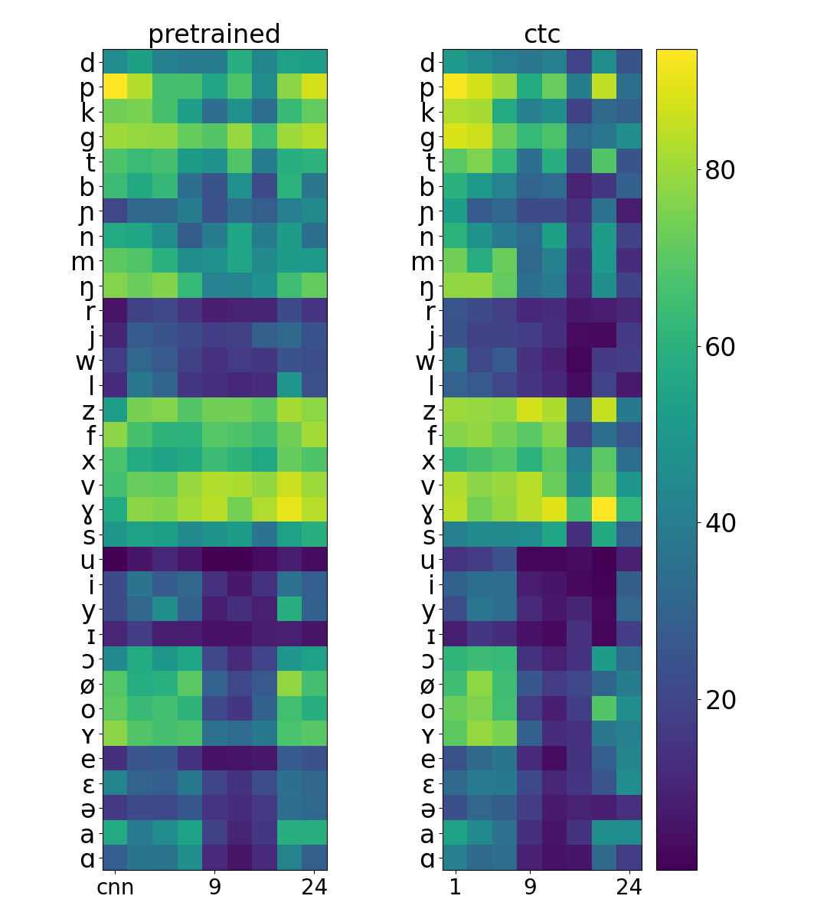
Figure 3: The percentage of second-best phones sharing the same broad phonetic class as the winning phone (y-axis), as classified by the multi-layer perceptron trained on a
given layer(x-axis) of the Wav2vec2 model.
Three million (winner, runner-up) pairs
Left: pre-trained
Right: ctc fine-tuned.

Slide 23
Probability → distance
d ∼ 1/(N + R)
in which d denotes the distance between winning phone and runner-up, N denotes the number of counts of the runner-up given the winner phone, and R is a regularisation term that corrects for very infrequent combinations.
  These infrequent combinations will certainly appear since, for example, /p/ will hardly occur as second candidate after /a/.
  In those cases, the formula predicts a large distance d between /a/ and /p/, and its numerical upperbound is determined by R.
Next, we use multi-dimensional scaling (MDS) to build a global 2D map, based on the phone-phone distances d.
  We used MDS rather than other visual-ization methods such as t-Distributed Stochastic Neighbor Embedding (t-SNE) since we focus on the local and global relations between phones instead of on clustering.

Slide 24
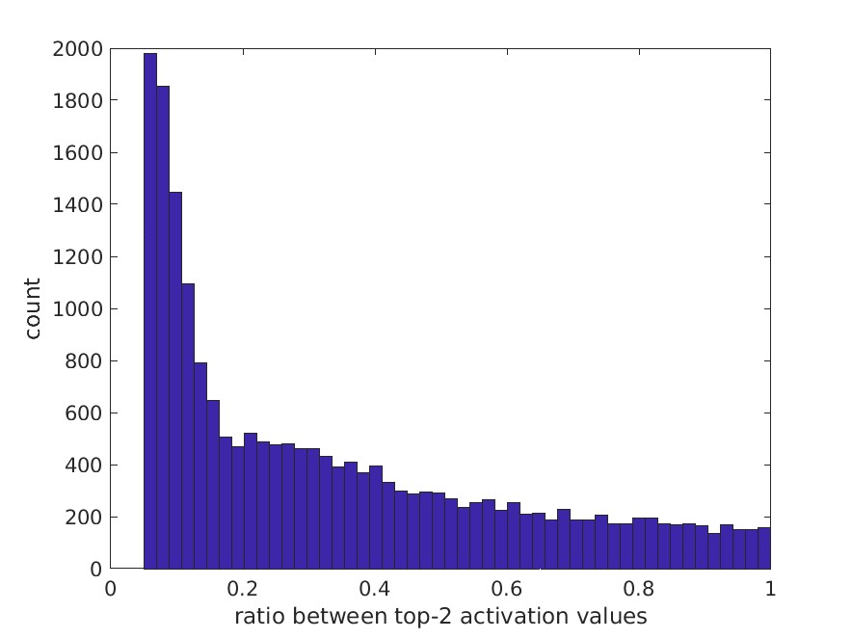
Study 3. Competition
This figure shows the competition between the winner phone and the runner up in terms of their scores in the logit matrix (the ratio)
The bulk has a low entropy

Slide 25
Results suggest that
MLP-based classifiers perform adequately on the latent representations for all layers
phone-phone structure shows a varying pattern across layers
→ while phone classifiers are able to produce a likely correct winner given a latent representation, a phonetically motivated phone-phone structure in the latent space is not necessary
In order to investigate this further, we study the competition between phones according to the MLP classification

Slide 26
(Winner, runner-up) - statistics
We zoom in into the statistics of the recognized phone and its runner-up, by counting the number of times a given phone appears as the runner-up of a winning phone
N(runner_up | winning phone)
Next figure gives a pictorial overview of the percentage of runner-up phones sharing the same broad phonetic class (BPC) as the winning phone, a cross all MLP-output vectors on a particular layer.

Slide 27
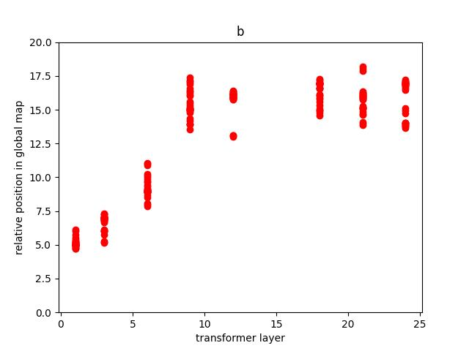

Slide 28
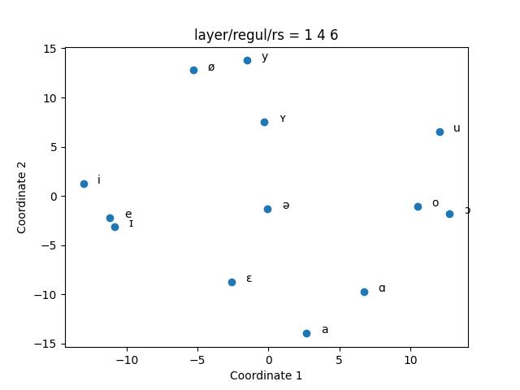

Slide 29
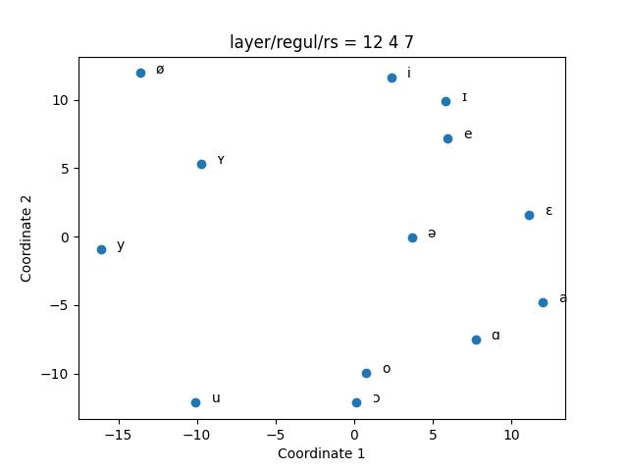

Slide 30
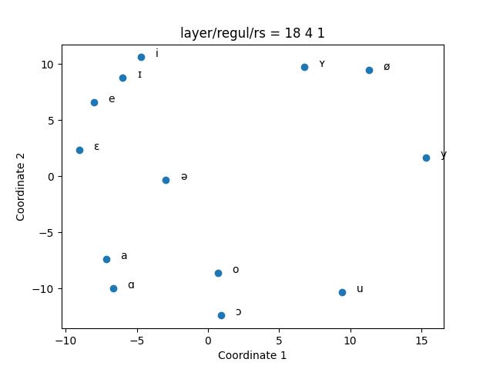

Slide 31
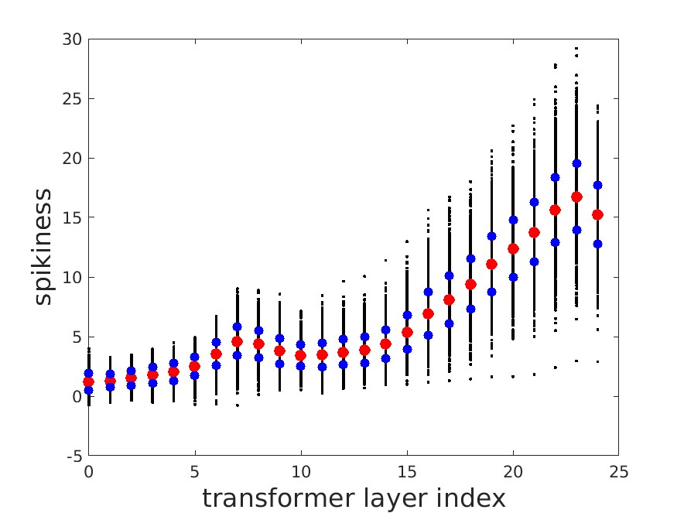

Slide 32
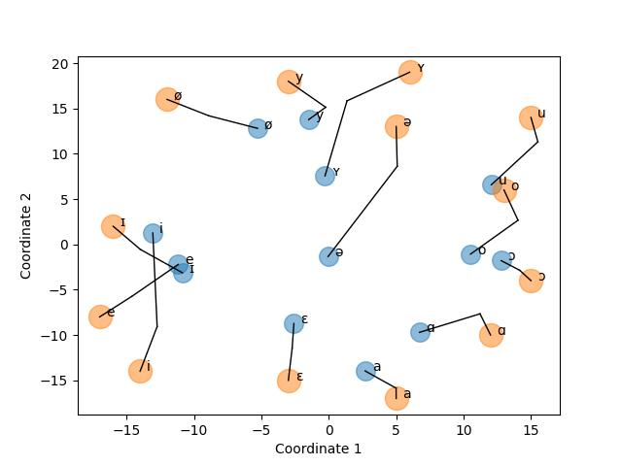
Figure 4:
MDS locations of Dutch vowels (monophthongs), after averaging over 50 different MDS runs;
PCA-based corrective rotations are used before creating the overlay.
The smaller light-blue markers denote the positions based on transformer layer 1; the larger light-orange markers denote the positions at layer 18; the connecting lines indicate the (simplified) route of the MDS solutions going from transformer layer 1 to transformer layer 18.
(Applicability of the Euclidean distance assumed.)

Slide 33
Preparing for linear separability??
Figure 4 shows the MDS positions of vowels based on the distances obtained via Eq. 2 from the runner-up distribution in layers 1 and 18 of the transformerblock, respectively.
For layer 1 (represented by smaller light-blue markers) the vowel triangle (cf. [5]) is clearly respected,and the topology of the resulting configuration is very close tothe Dutch vowel system.
For higher layers, the MDS solution moves away from the configuration found for layer 1 – vowels are pushed apart towards a much more convex vowel configu-ration.
An increasing convexity of the configuration can be understood as preparing the latent representation for enabling the ultimate layer to make decisions using linear hyperplanes.

Slide 34
Results
Finetuned Wav2vec2 models can produce high-quality transcriptions on the phone level (8.3% on TIMIT test).
Wav2vec2 does not show how confusable phones compete.
Due to the CTC algorithm, the score distance between the winner and all competitors is (usually) very large, and the rank order of the competing phones may be seemingly random,
Wav2vec2 model fine-tuned with CTC is a good phone decision machine, but a poor machine when it comes to describing phonetic structure

Slide 35
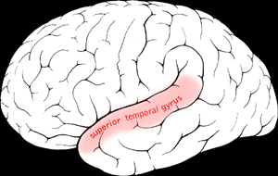
Relation with the brain???
The Superior Temporal Gyrus (STG) represents the input speech via nonlinear processes …

Slide 36
superior temporal gyrus (STG)
Speech processing in the human brain is based on a transformation from acoustic speech signals into internal representations via non-linear operations in the STG.
The STG contains the non primary auditory cortex where phonological processing is known to take place.
  It represents the input speech via nonlinear processes that include spectro-temporal processing, normalization and restoration based on context, and involves complex auditory encoding for acoustic-phonetic and prosodic features.

Slide 37
Side issue: Effect of CTC

Slide 38
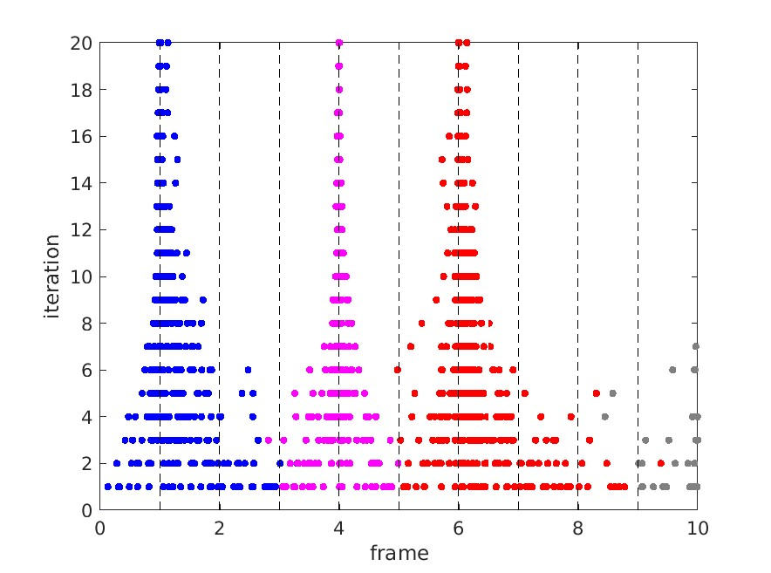

Slide 39
